Slide 1
INT222 - Internet Fundamentals
Week 7: CSS Properties,
Page Layouts and Navigation

Slide 2
Agenda
CSS Styling
lists, tables and hyperlinks
CSS Centering
CSS Positioning
Page Layouts and Navigation
Introduction to DOM

Slide 3
CSS Lists
The list-style-type CSS property specifies appearance of a list item element.
Examples:
{ list-style-type:circle; } { list-style-type:square; } { list-style-type:upper-roman; } { list-style-type:lower-alpha; }
Default value: disc
css_list.html

Slide 4
Property list-style-type Values
Value | Description | e.g.
none | No item marker is shown
disc | A filled circle (default value)
circle | A hollow circle
square | A filled square
decimal | Han decimal numbers | 1, 2,
decimal-leading-zero | Decimal numbers | 01, 02, 03, … 98
lower-roman | Lowercase roman numerals | i, ii, iii, iv, v…
upper-roman | Uppercase roman numerals | II, III, IV, V…
lower-greek | Lowercase classical Greek | α, β, γ…
lower-alpha, lower-latin | Lowercase ASCII letters | a, b, c, … z
upper-alpha, upper-latin | Uppercase ASCII letters | A, B, C, … Z
More list-style-type values| MDN

Slide 5
Table Formatting
CSS properties for table formatting:
margin, padding, width, height, text-align, vertical-align, background-color, background-image, border
Border Collapse
Property: border-collapse sets whether the table borders are collapsed into a single border or separated.
e.g.:
Table { border-collapse:collapse; }
table,th, td { border: 1px solid black; }

Slide 6
Table Formatting
Formatting The Entire Table:
table { margin: auto; width: 80%; }
table { border: dotted; }
table { background-color: yellow; }
Formatting Table Cells
td {border: 4px inset #4400FF}
td {padding:10px 20px}
td {background-color: aqua}
td {height: 100px; width: 400px}
using "text-align" and "vertical-align"
css_table.html

Slide 7
Border Collapse
7
Property: border-collapse sets whether the table borders are collapsed into a single border or separated.
E.g.:
table { border-collapse:collapse; } table, th, td { border: 1px solid black; }

Slide 8
Table Sections
<thead> - group the first one or more rows of a table for formatting
<tbody> - group the middle rows of a table for formatting
<tfoot> - group the last one or more rows of a table for formatting
css_table_section.html

Slide 9
Styling Links
Properties:
color, font-family, background
Links are styled differently depending on what state they are in.
The four link states are:
a:link - a normal, unvisited link
a:visited - a link the user has visited
a:hover - a link when the cursor hovers over it
a:active - a link the moment it is clicked
Note: When setting the style for several link states,
a:hover MUST come after a:link and a:visited
a:active MUST come after a:hover
css_link.html css_link-as-button.html

Slide 10
CSS – display Property
The display CSS property specifies the type of rendering box used for an element.
Defaule value: inline
The value none lets you turn off the display of an element.
e.g.
p.inline { display: inline; }
css_display.html

Slide 11
The display Property Values
Value | Description
inline | Default value. Displays an element as an inline element (like <span>)
block | Displays an element as a block element (like <p>)
inline-block | Displays an element as an inline-level block container. The inside of this block is formatted as block-level box, and the element itself is formatted as an inline-level box
inline-table | The element is displayed as an inline-level table
list-item | Let the element behave like a <li> element
table | Let the element behave like a <table> element
table-caption | Let the element behave like a <caption> element
table-column-group | Let the element behave like a <colgroup> element
table-header-group | Let the element behave like a <thead> element
table-footer-group | Let the element behave like a <tfoot> element
table-row-group | Let the element behave like a <tbody> element
table-cell | Let the element behave like a <td> element
table-column | Let the element behave like a <col> element
table-row | Let the element behave like a <tr> element
none | The element will not be displayed at all (has no effect on layout)

Slide 12
Centering - Lines Of Text
Centering lines of text in a paragraph or in a heading.
p { text-align: center }
h2 { text-align: center }
center_text.html

Slide 13
Centering – a Block
Rephrase: left and right margin to be equal.
set the margins to 'auto'.
used with a block of fixed width.
div.center { border: 2px solid red;
margin-left: auto;
margin-right: auto;
width: 400px; }
<div class ="center"> … </div>
center_block.html

Slide 14
Centering – Vertically
Specify the outer block as a table cell, the contents of a table cell can be centered vertically.
div { height: 100px; width: 500px; }
div.center { border: 10px dotted red;
display: table-cell;
vertical-align: middle;
text-align: center;}
<div class="center"> This div is centered </div>
center_vertical.html

Slide 15
Positioning
CSS position property
can be used to position elements precisely in HTML pages.
a browser renders html statements in the order that they are in the html file - this is called normal flow

Slide 16
Positioning
Values for property: position
absolute - position precisely within the containing element
relative - position precisely relative to normal flow
fixed - position precisely within the browser window, and does not move when the page is scrolled
static - position using normal flow (default)
Values for Properties: "left", "right", "top", and "bottom" can be given offsets in px or %
<div> tags, with various classes, are used to create the different divisions of the document.
position.html
Position_relative.html

Slide 17
Positioning
What if the text takes more than the allotted space?
use the property "overflow" to specify an action:
{ overflow:scroll; } - include scroll bars
{ overflow:auto; } - scroll if required
{ overflow:hidden; } - hide overflow
{ overflow:visible; } – default
position.html

Slide 18
Positioning
graphics and titles can be positioned in a similar fashion:
position_graphic.html

Slide 19
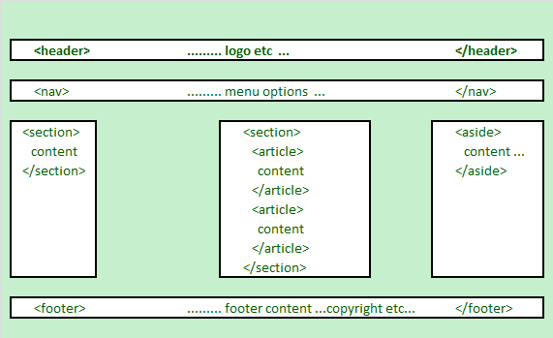
HTML5 Structural Elements
HTML 5 defines a number of new container elements for constructing documents.
header, nav, section, aside, article and footer

Slide 20
HTML5 Structural Elements
Elements | Description
<header> | the web page/site header content
<nav> | the navigation functionality for the page/site.
<section> | the grouping of related subjects on the web page.
<main> | the main content on the web page.
<article> | contains a standalone content on the web page.
<aside> | used for content that's not central to the web page.
<footer> | the web page/site footer content
Notes: The <div> element is the generic container for flow content, which does not
inherently represent anything. It should be used only when no other semantic element
(such as above elements) is appropriate.

Slide 21
HTML5 Structural Elements
<body>
<header>......... logo etc …
</header>
<nav> ......... menu options …
</nav>
<section id="sidebar1">......... section 1 …
</section>
<section id="main"><!-- may be replaced by main element -->
<article>article within the section </article>
<article>another article within the section </article>
</section>
<aside>......... aside content …
</aside>
<footer> ......... footer content ...copyright etc…
</footer>
</body>
html5_structure.html

Slide 22
<article> Tags Can Contain Others
<article>
<header>
</header>
<section id="introduction">
</section>
<section id="content">
</section>
<section id="summary">
</section>
<footer>
</footer>
</article>

Slide 23
The HTML4 Structural Elements: <div>
<body>
<div class="header">......... logo etc …
</div>
<div class="navigation"> ......... menu options …
</div>
<div class ="sidebar1">......... Column 1 …
</div>
<div class="main">
…………….main column content goes in here………….
</div >
<div class="aside">......... aside content …
</div>
<div class="footer"> ......... footer content ...copyright etc…
</div>
</body>

Slide 24
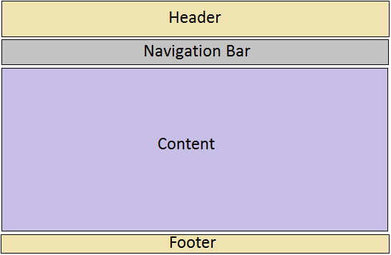
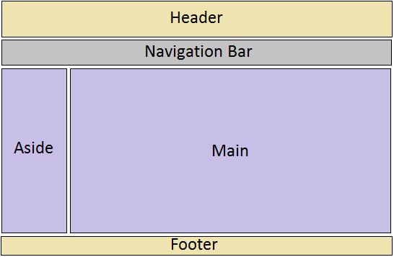
Web Pages Layouts
One-column layout
layout-1-column.html
Two-column layout
layout-2-column.html

Slide 25
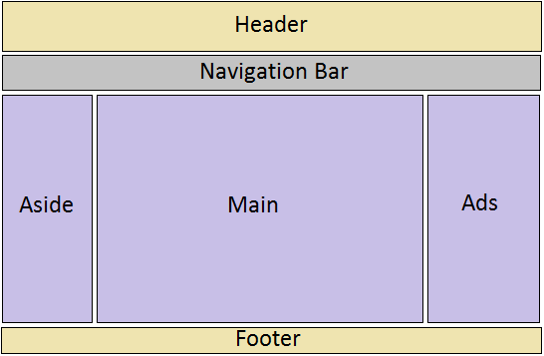
Web Pages Layouts
Three-column layout
layout-3-column.html

Slide 26
Create Layouts with HTML5 and CSS3
Creating 2-column fluid (float-based) layouts with CSS
HTML5 document without CSS:
html5_structure.html
Set the width of the page (e.g. 960px) and center the page:
.container { width: 960px; margin: auto; }
Set the width of the “aside” block and float it to left:
aside { width: 192px; float: left; }
Set the width of the “main” section and float it to left:
section.main { width: 768px; float: left; }

Slide 27
Create Layouts with HTML5 and CSS3
Set the clear property of the footer to ‘both’:
footer { clear: both; background-color: #aaa; }
Set margin, border, padding, background-color, … to each structural element, e.g.:
aside, section.main {margin-top: 58px; margin-right: 10px; margin-left: 10px; }
Note: You may use relative width for the page and columns.

Slide 28
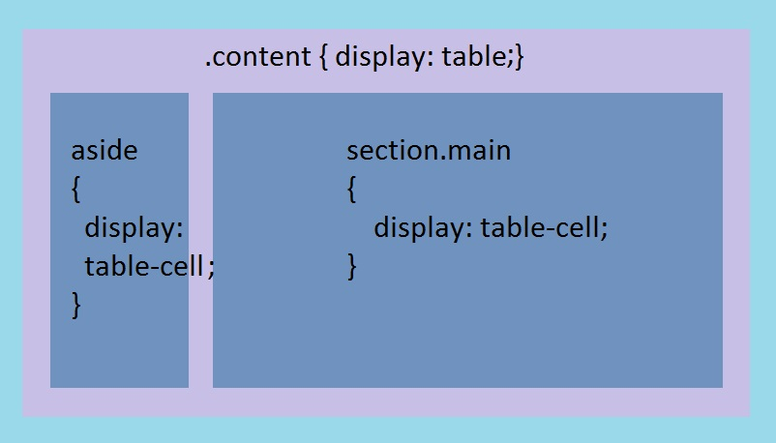
Create Layouts with HTML5 and CSS3
Creating 2-column tabular layouts with CSS
HTML5 document without CSS:
html5_structure.html
Set CSS:

Slide 29
Create Layouts with HTML5 and CSS3
Creating 2-column tabular layouts with CSS (cont’)
CSS code for 2-column tabular layouts :
.container { display: table; width: 960px; margin: auto; }
aside { display: table-cell; width: 192px; }
section.main { display: table-cell; width: 720px; }
footer { background-color: #aaa; }
aside, section.main {margin-top: 58px; margin-right: 10px; margin-left: 10px;
Note: using HTML table to create page layouts is obsolete and not allowed in INT222 assignments

Slide 30
Navigation and Menus
Web page navigation
<nav>
<ul>
<li><a href="#top">Home</a></li>
<li><a href="#timetable">Timetable</a></li>
<li><a href="#standards">Standards</a></li>
<li><a href="ibc233/ibc233.html">IBC233</a></li>
<li><a href="int222/int222.html">INT222</a></li>
<li><a href="bti220/bti220.html">BTI220</a></li>
</ul>
</nav>
convert the unordered the list a navigation bar or menu.

Slide 31
Navigation and Menus
Single Level Menu Options
Horizontal Single Level Menu Example
Navigation bar
Vertical Single Level Menu Example
Multi Level Menu Options
Horizontal Multi Level Menu Example
Vertical Multi Level Menu Example

Slide 32
Introduction to DOM

Slide 33
Document Object Model (DOM)
The Document Object Model (DOM) is an 2-way application programming interface (API) for HTML (and XML) documents.
It defines the way how the document structure, style and content can be accessed and manipulated.
It provides a structured representation of the document.
It’s cross-platform and language-independent.
With the DOM, programmers can build documents, navigate their structure, and add, modify, or delete elements and content using JavaScript or other languages.

Slide 34
Document Object Model (DOM)
The document’s structure is defined by the W3C Document Object Model (DOM) specification.
A web browser provides and implements the DOM.
The DOM provides a representation of the document as a structured group of nodes and objects that have properties and methods.
It connects web pages to scripts or programming languages.

Slide 35
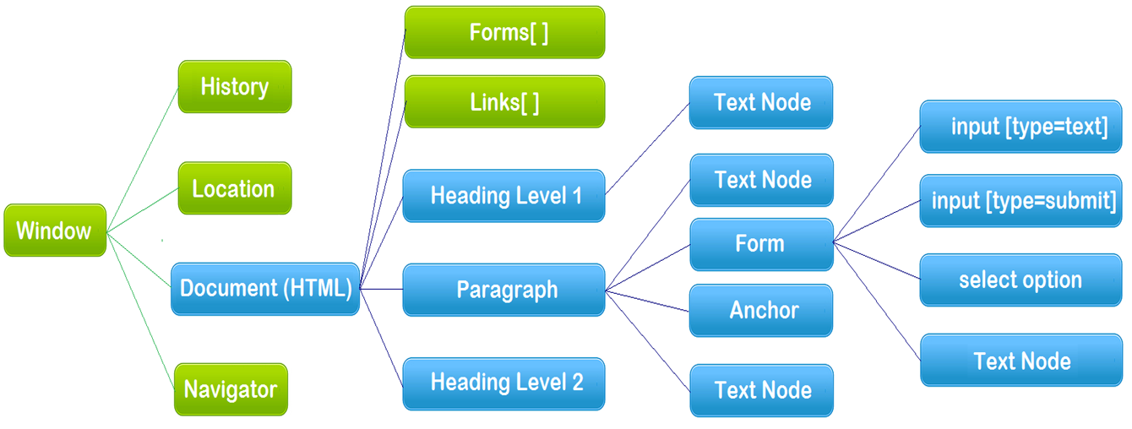
The Hierarchy of DOM
Everything in the Hierarchy of DOM is an object.
The Document Object Model: the blue color part

Slide 36
The Hierarchy of DOM
On the top the Hierarchy is the window object.
When JavaScript is hosted in a browser, the browser provides the window host object to JavaScript.
The window object possesses the properties of document, history, location and navigation objects.
The global functions are belong to the window object.
DOM
The DOM, strictly speaking, covers the document object and the objects underneath.
When an HTML document is loaded into a web browser, it becomes a document object.

Slide 37
Document Object
An HTML document loaded into a browser window becomes a Document object.
The Document object provides access to all HTML elements in a page, from within a script.
The Document object is also part of the Window object, and can be accessed through the window.document property.
The document object is the root node of the HTML document and the "owner" of all other nodes:
element nodes, text nodes, attribute nodes, and comment nodes.

Slide 38
Document Object
Document object properties and methods (legacy DOM):
document.anchors | Returns a collection of all the anchors in the document
document.body | Returns the body element of the document
document.domain | Returns the domain name of the server that loaded the document
document.forms | Returns a collection of all the forms in the document
document.images | Returns a collection of all the images in the document
document.links | Returns a collection of all the links in the document
document.referrer | Returns the URL of the document that loaded the current document
document.title | Sets or returns the title of the document
document.URL | Returns the full URL of the document
document.write() | Writes HTML expressions or JavaScript code to a document
document.writeln() | write() with a newline character after each statement

Slide 39
Document Object
The document object provides properties and methods to access all node/element objects, from within JavaScript.
Examples
A form input element could be accessed as either
document.formName.inputName
or
document.forms[0].elements[0]
// (if the input element is first element in the first form)
An image in a web page can be accessed via
document.images[0] // (the 1st image in the page)
document.html

Slide 40
Document Object
Document object methods – get/query element(s):
document.getElementById()
document.getElementsByName()
document.getElementsByClassName()
document.getElementsByTagName()
document.querySelector()
Returns the first element that matches a specified CSS selector(s) in the document
document.querySelectorAll()
Returns a static NodeList containing all elements that matches a specified CSS selector(s) in the document
Examples:
var elem = document.getElementById("demo");
var paras = document.getElementsByTagName("p");
var example = document.querySelector("p.example");

Slide 41
Document Object
Document object methods – create element(s), …
document.createElement()
document.createTextNode()
document.createAttribute()
document.createComment()
document.addEventListener()
create-element.html

Slide 42
update elements
Example 1:
document.getElementById("demo").innerHTML = "Hello World";
Example 2:
var i, elems = document.getElementsByName("pets");
for (i = 0; i < elems.length; i += 1) {
// elems[i].type = "checkbox";
elems[i].setAttribute('type', 'checkbox');
}
Example 3:
document.querySelector(".example").style.backgroundColor = "red";
update-elements.html

Slide 43
Element innerHTML property
An element’s innerHTML property sets or gets the HTML text content of the element.
Example 1:
HTML: <p id="demo">Welcome to Seneca College!</p>
JS: var elem = document.getElementById("demo");
alert("The text in the paragraph: " + elem.innerHTML);
elem.innerHTML = prompt("Please input some text");
Example 2:
HTML: <div id=display></div>
JS: var elem = document.getElementById("display");
elem.innerHTML = "<p>Paragraph added/changed!</p>";
elem.innerHTML += '<ul><li>Coffee</li><li>Tea</li></ul>';
// Writing HTML within JavaScript is not a good practice. Use DOM instead if possible.
innerHTML.html

Slide 44
Resourceful Links
CSS Library
Making a Sphere in CSS
MDN - Document Object Model (DOM)
MDN – Node (interface) reference
MDN – Element (interface) reference
MDN – Text (interface) reference

Slide 45
Thank You!

